Slide 1
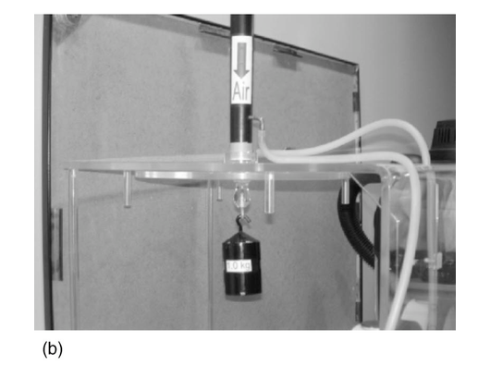
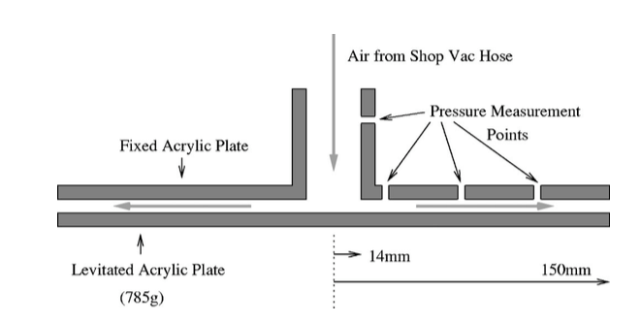
Dry Water : Consequences
Bernoulli levitation:
The calculation uses friction factor, so this is not completely Bernoulli!
Bernoulli levitation,
Waltham, Bendall, and
Kotlicki, Am. J. Phys. 2002

Slide 2
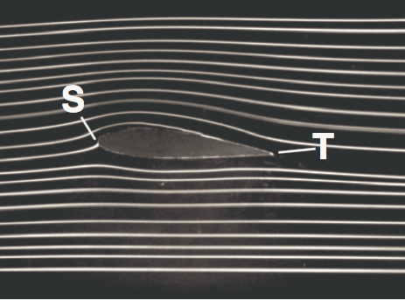
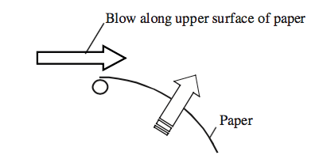
Can Bernoulli fly aeroplanes ?
Arguments:
Wing is curved on one side and straight on the other. So two fluid particles – one above and one below – following two different streamlines move from S to T in the same time.
So the velocity is higher above than below.
So by Bernoulli’s theorem the pressure is higher below than above. This gives the lift.

Slide 3
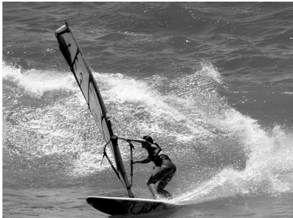
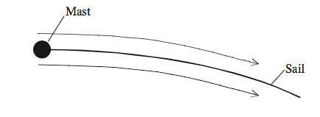
No, he cannot
Counter-arguments:
Bernoulli’s equation applies to individual streamlines, cannot be used between two different ones.
You do not need two different paths along top and bottom to generate a lift. An example is the force on a sail.
“How wings work ?” H. Babinsky
Phys. Educ, 2003

Slide 4
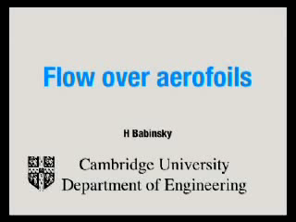
Do two fluid particles really move from S to T in the same time ?

Slide 5
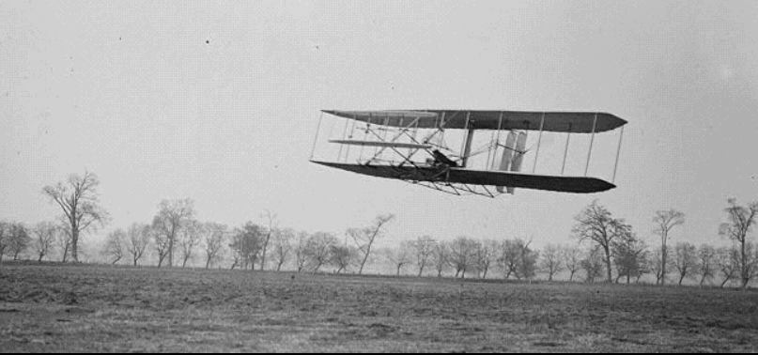
So how do we fly then ?
well, I am not telling you now. But remember that without viscosity, which in not in Bernoulli’s equations, there is neither drag nor lift.

Slide 6
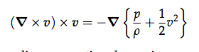
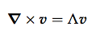
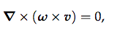
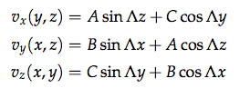
A solution to the Euler equation
Steady and absence of gravity:
A solution, not “the” solution.

Slide 7
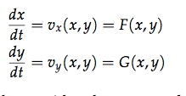
Streamlines (2d)

Slide 8
more streamlines (2d)

Slide 9
more streamlines (2d)
E
H
E
H
H
E
H
H
E
Elliptic and Hyperbolic points

Slide 10
even more streamlines (2d)

Slide 11
Streamlines in 2d
In 2d there is are two variables, one equation and one constraint (conservation of energy). Hence, once you fix the initial condition the motion is constrained on a curve. For example, in the base below, x^2+y^2 is constant and the other coordinate is a periodic variable.

Slide 12
Streamlines in 3d
In 3d there are three variables but one constraint so once you fix the initial condition the motion happens on a surface, however complicated. Hence it is described by two coordinates.
Now the streamlines are not, in general, integrable. (They can still be calculated though).
They can be chaotic.

Slide 13
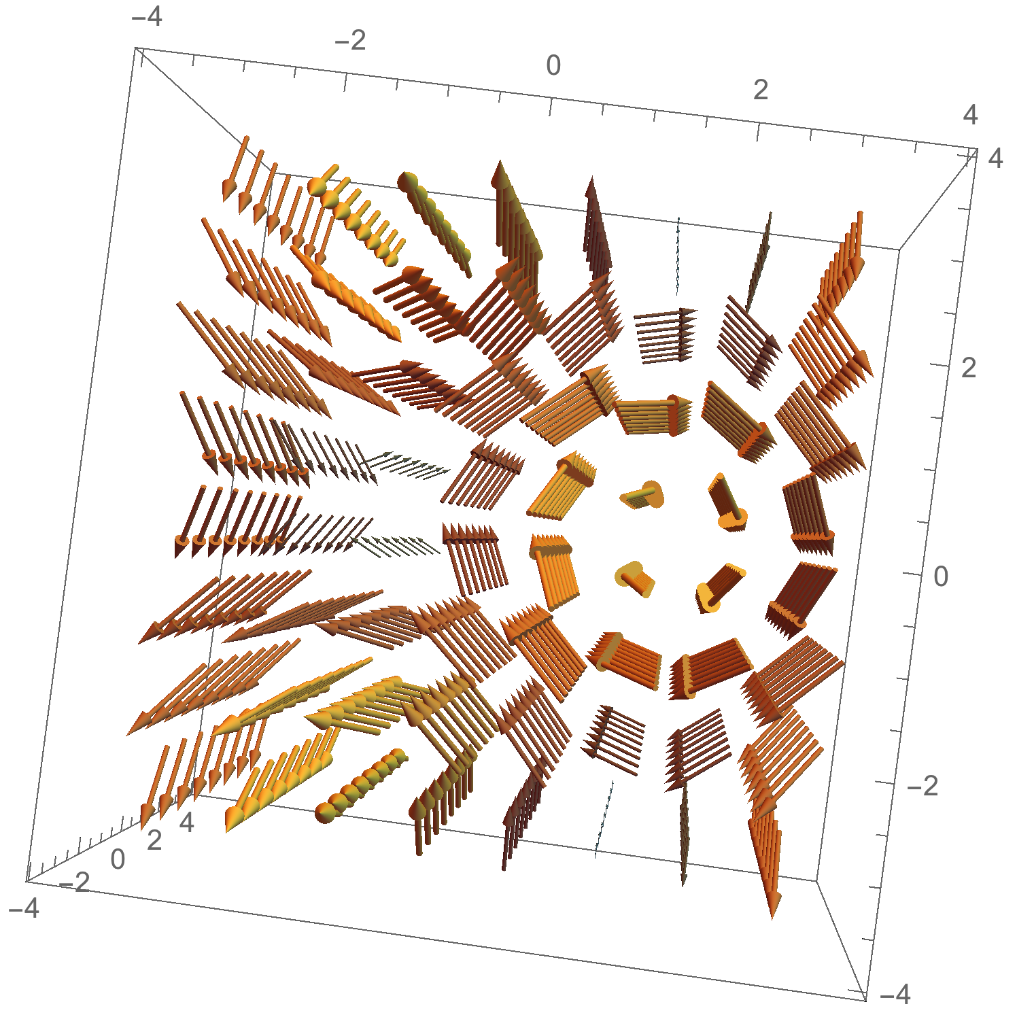
ABC streamlines (C=0)

Slide 14
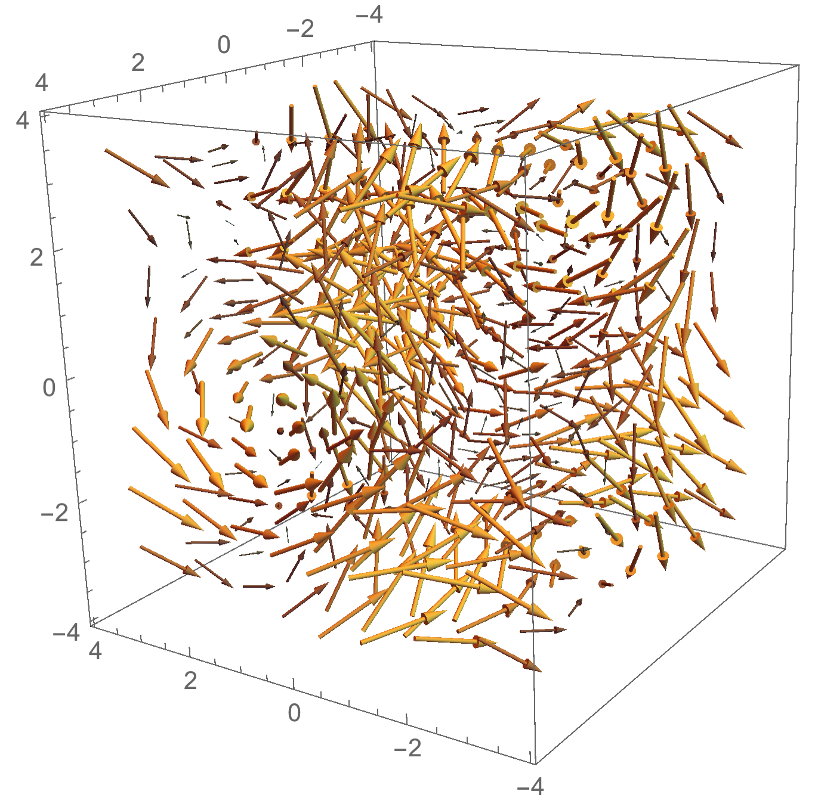
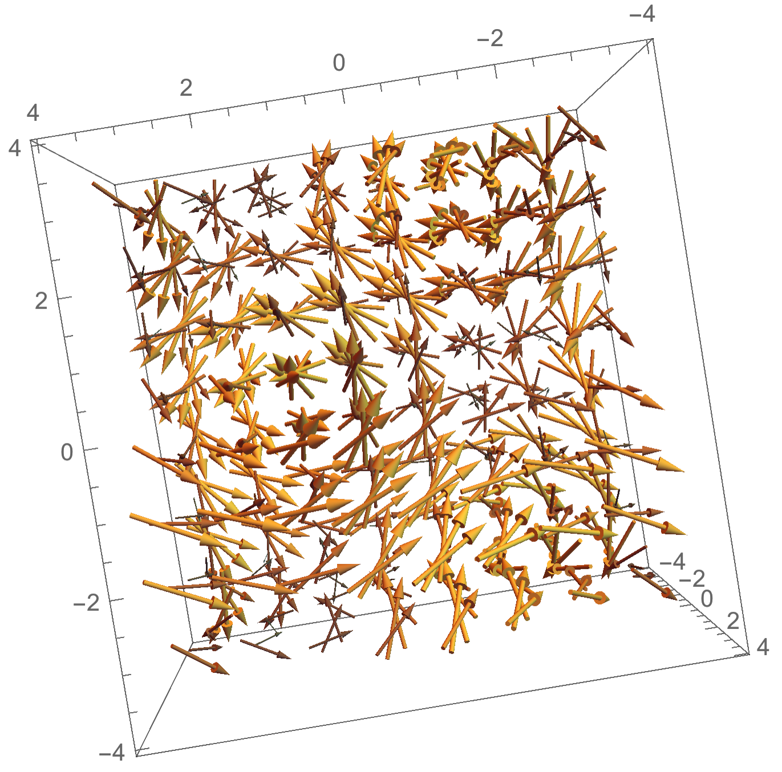
ABC streamlines

Slide 15
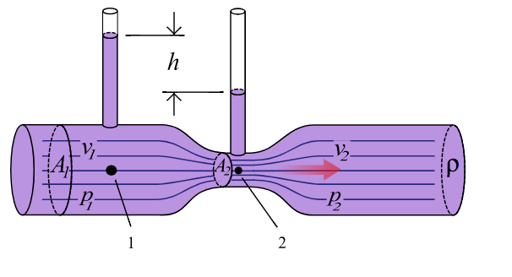
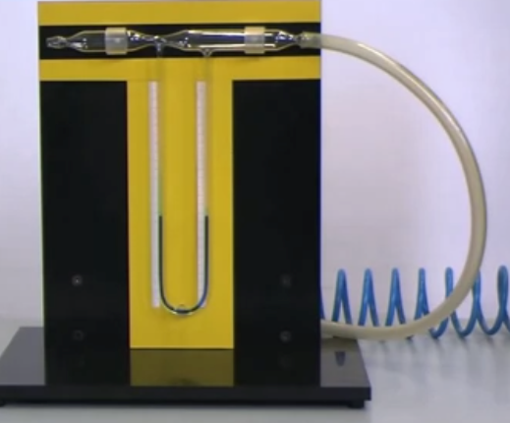
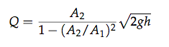
Venturi tube
picture credit : Wikipedia

Slide 16
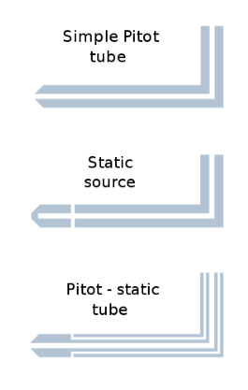
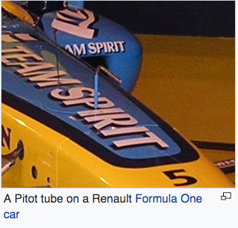
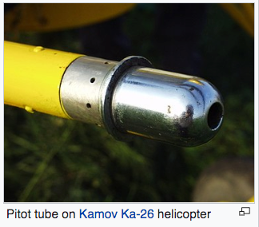
Pitot tube
image source : wikipedia

Slide 17
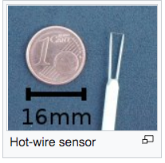
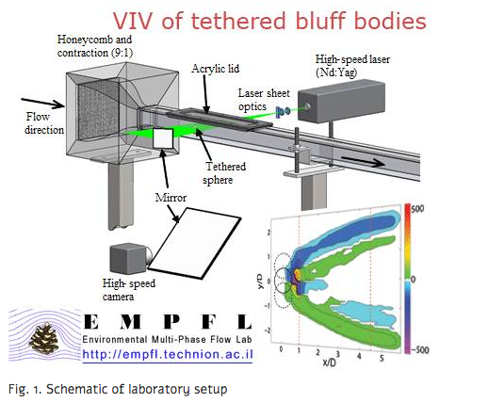
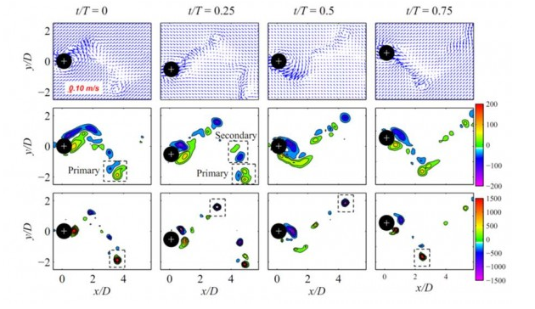
Anemometers and PIV
image credit: https://meeng.technion.ac.il/oscillations-of-tethered-bodies-as-a-result-of-fluid-structure-interaction/

Slide 18

Complex fluids
shear-thinning
“water+pollen”
“wet sand”
“honey”
“cornstarch solution”
“water”
Inertial
shear-thickenning
Newtonian fluid with additives as model for complex fluid.

Slide 19
Complex fluids
shear-thinning
“water+pollen”
“wet sand”
“honey”
“cornstarch solution”
“water”
Inertial
shear-thickenning
Newtonian fluid with additives as model for complex fluid.

Slide 20
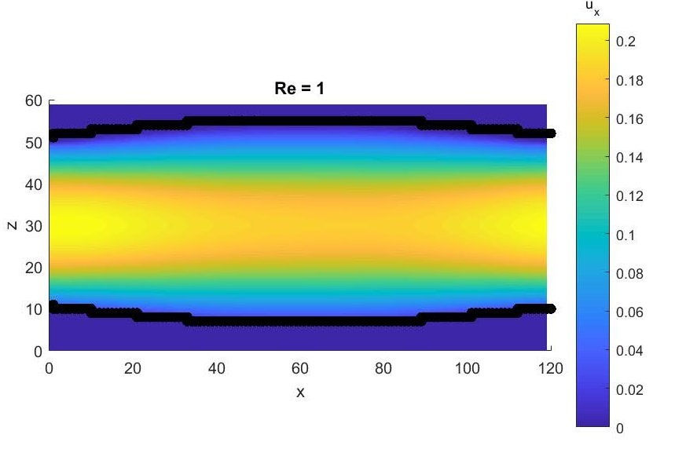
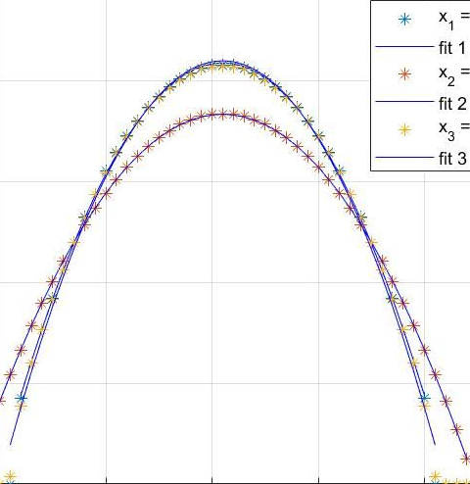
Lattice Boltzman simulation of flow in a non-uniform channel
Simulations by Lukas Cendblad

